Slide 1
Backend
Computer Engineering Essential
Naravich Chutisilp (Namkang🧊)

Slide 2
Traditional Web Dev

Slide 3



3-Tier Architecture
Frontend
Backend
Database
Icons made by "Freepik" from www.flaticon.com

Slide 4
3-Tier Architecture
Frontend
Backend
Database
Code
Code
Code
Icons made by "Freepik" from www.flaticon.com

Slide 5


Slide 6


Slide 7
3-Tier Architecture
Frontend
Backend
Database
Code
Code
Code
Icons made by "Freepik" from www.flaticon.com

Slide 8

3-Tier Architecture
Frontend
Backend
Database
Code
Code
Code
Icons made by "Freepik" from www.flaticon.com

Slide 9
Technical Brief

Slide 10
Adding SDK

Slide 11
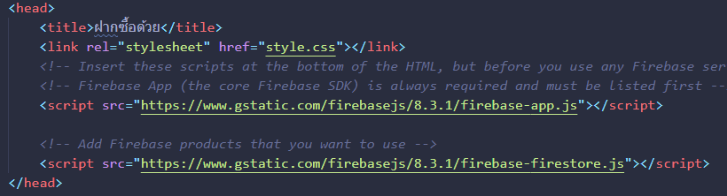
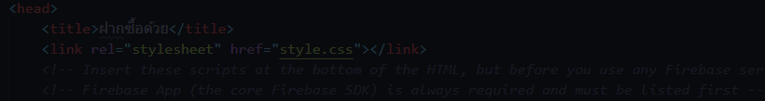
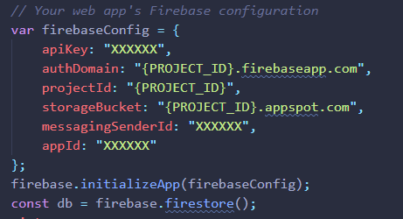
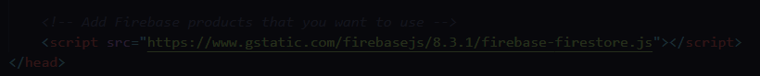
After Adding SDK You Will Have a Variable (`firebase`)

Slide 12
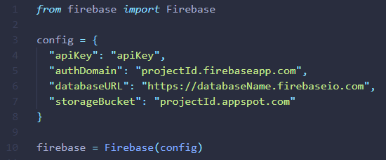

Adding SDK ~ import Library

Slide 13
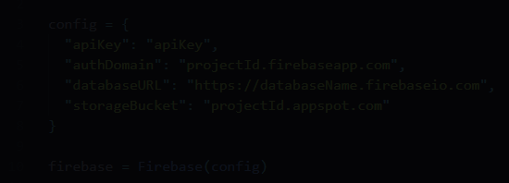
Adding SDK ~ import Library

Slide 17
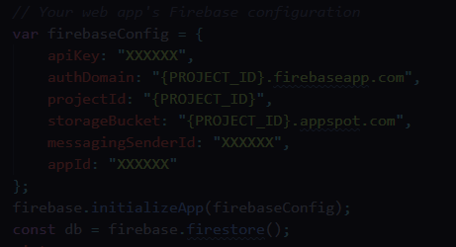
After Adding SDK You Will Have a Variable (`firebase`)

Slide 18
JavaScript

Slide 19
Async Await

Slide 20
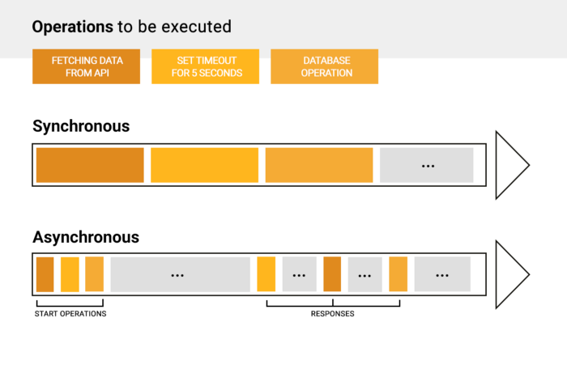
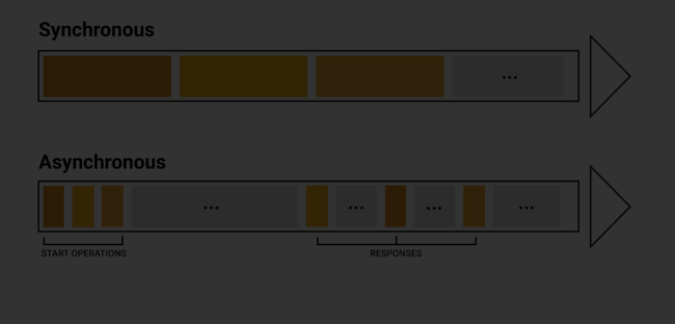
Asynchronous Function

Slide 21
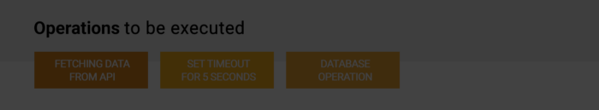
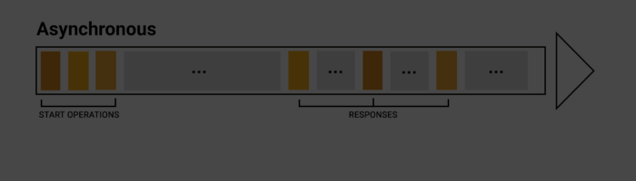
Asynchronous Function

Slide 22
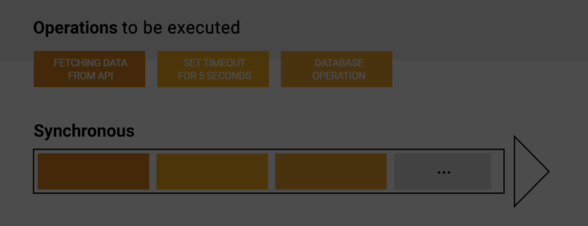
Asynchronous Function

Slide 23
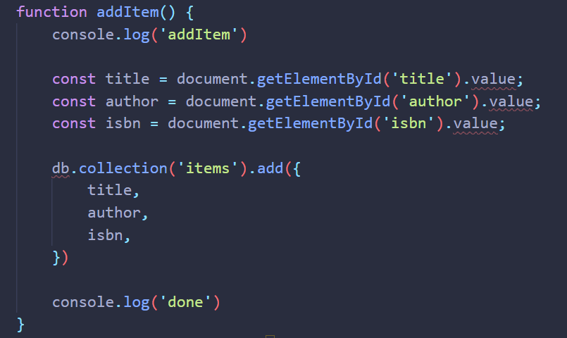

Slide 24
⛅
“addItem” ⛅
1
🔥
“Done” 🏁
2
🏁
Item Added to Firestore🔥
3

Slide 25
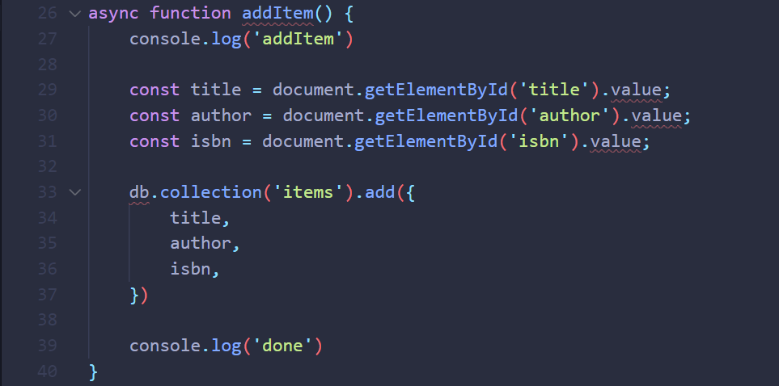

Slide 26
Determine Asynchronous Function

Slide 27
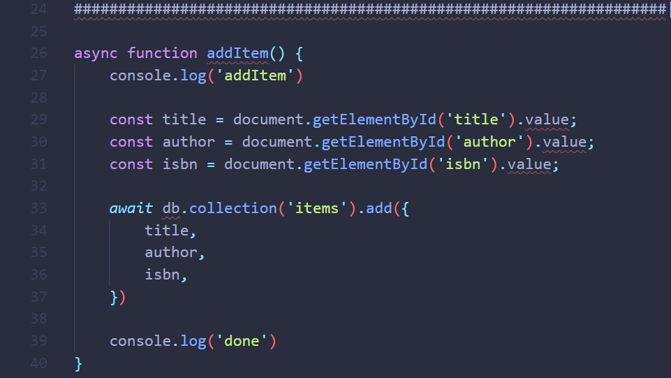
Wait for Asynchronous Function to Finish

Slide 28
⛅
“addItem” ⛅
1
🔥
Item Added to Firestore🔥
2
🏁
“Done” 🏁
3

Slide 29
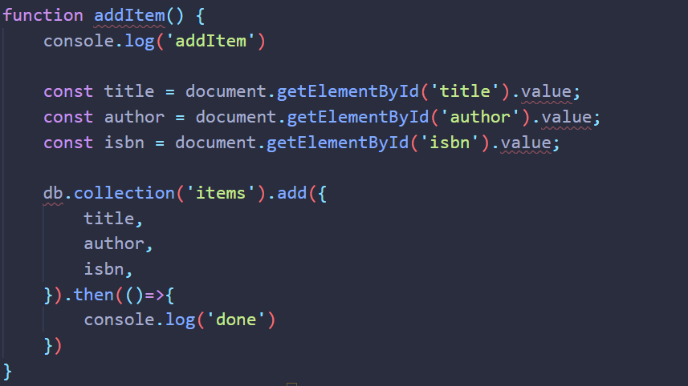
Alternative Solution using Then
}

Slide 30
Await หรือ Then ได้กินข้าวกับเพื่อน?
Await = รอให้เสร็จแล้วทำ … ต่อ
.then = ทำ (...) เมื่อเสร็จ
เพื่อนทำการบ้าน
เพื่อนทำการบ้าน
await
โทรบอกว่าเสร็จ
โทรบอกว่าเสร็จ
.then( )
กินข้าว
กินข้าว

Slide 31
JS Miscellaneous

Slide 32
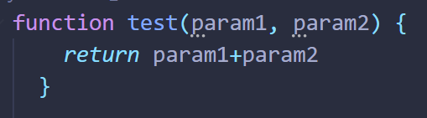
Arrow Function
param1 = 3
param2 = 1
test(param1, param2) = 4

Slide 33
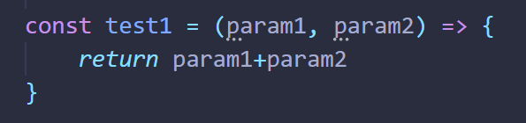

Arrow Function
param1 = 3
param2 = 1
test(param1, param2) = 4
test1(param1, param2) = 4
test2(param1, param2) = 4

Slide 34
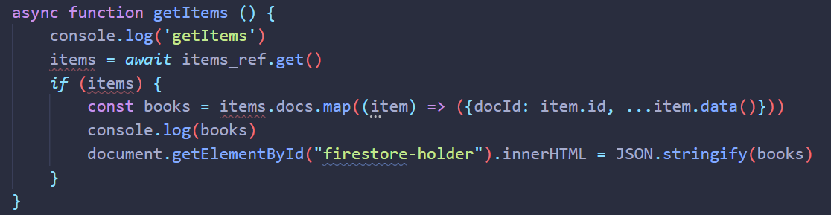
Map an Array with Arrow Function in Preparation

Slide 35
Map an Array with Arrow Function in Preparation

Slide 36

Map an Array with Arrow Function in Preparation

Slide 37
Map an Array with Arrow Function in Preparation
Array
Arrow Function

Slide 38
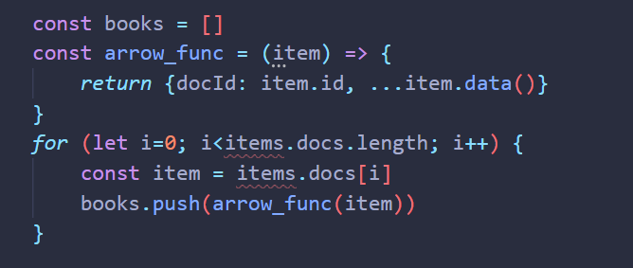
Map an Array with Arrow Function in Preparation
Array
Arrow Function

Slide 39
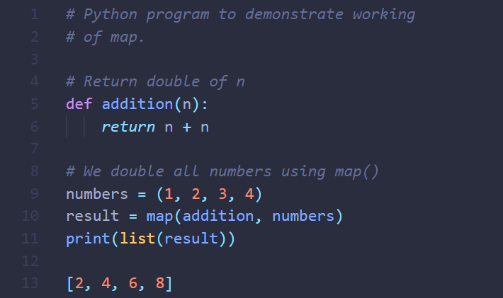
Map an Array with Arrow Function in Preparation
Array
Arrow Function

Slide 40
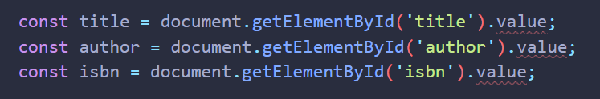
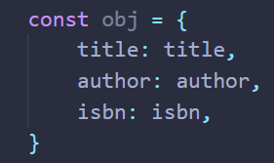
Object Declaration

Slide 41
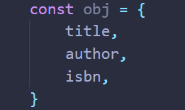
Object Declaration

Slide 42
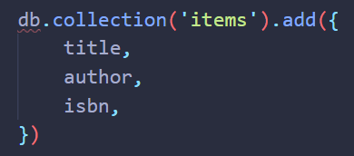
Object Declaration

